Slide 1

Skills workshop for staff members Planning
Prepared by
Trinh Duc Anh
Bui Huong Linh
Nguyen Duc Anh
Nguyen Van Hoa
Nguyen The Vinh

Slide 2
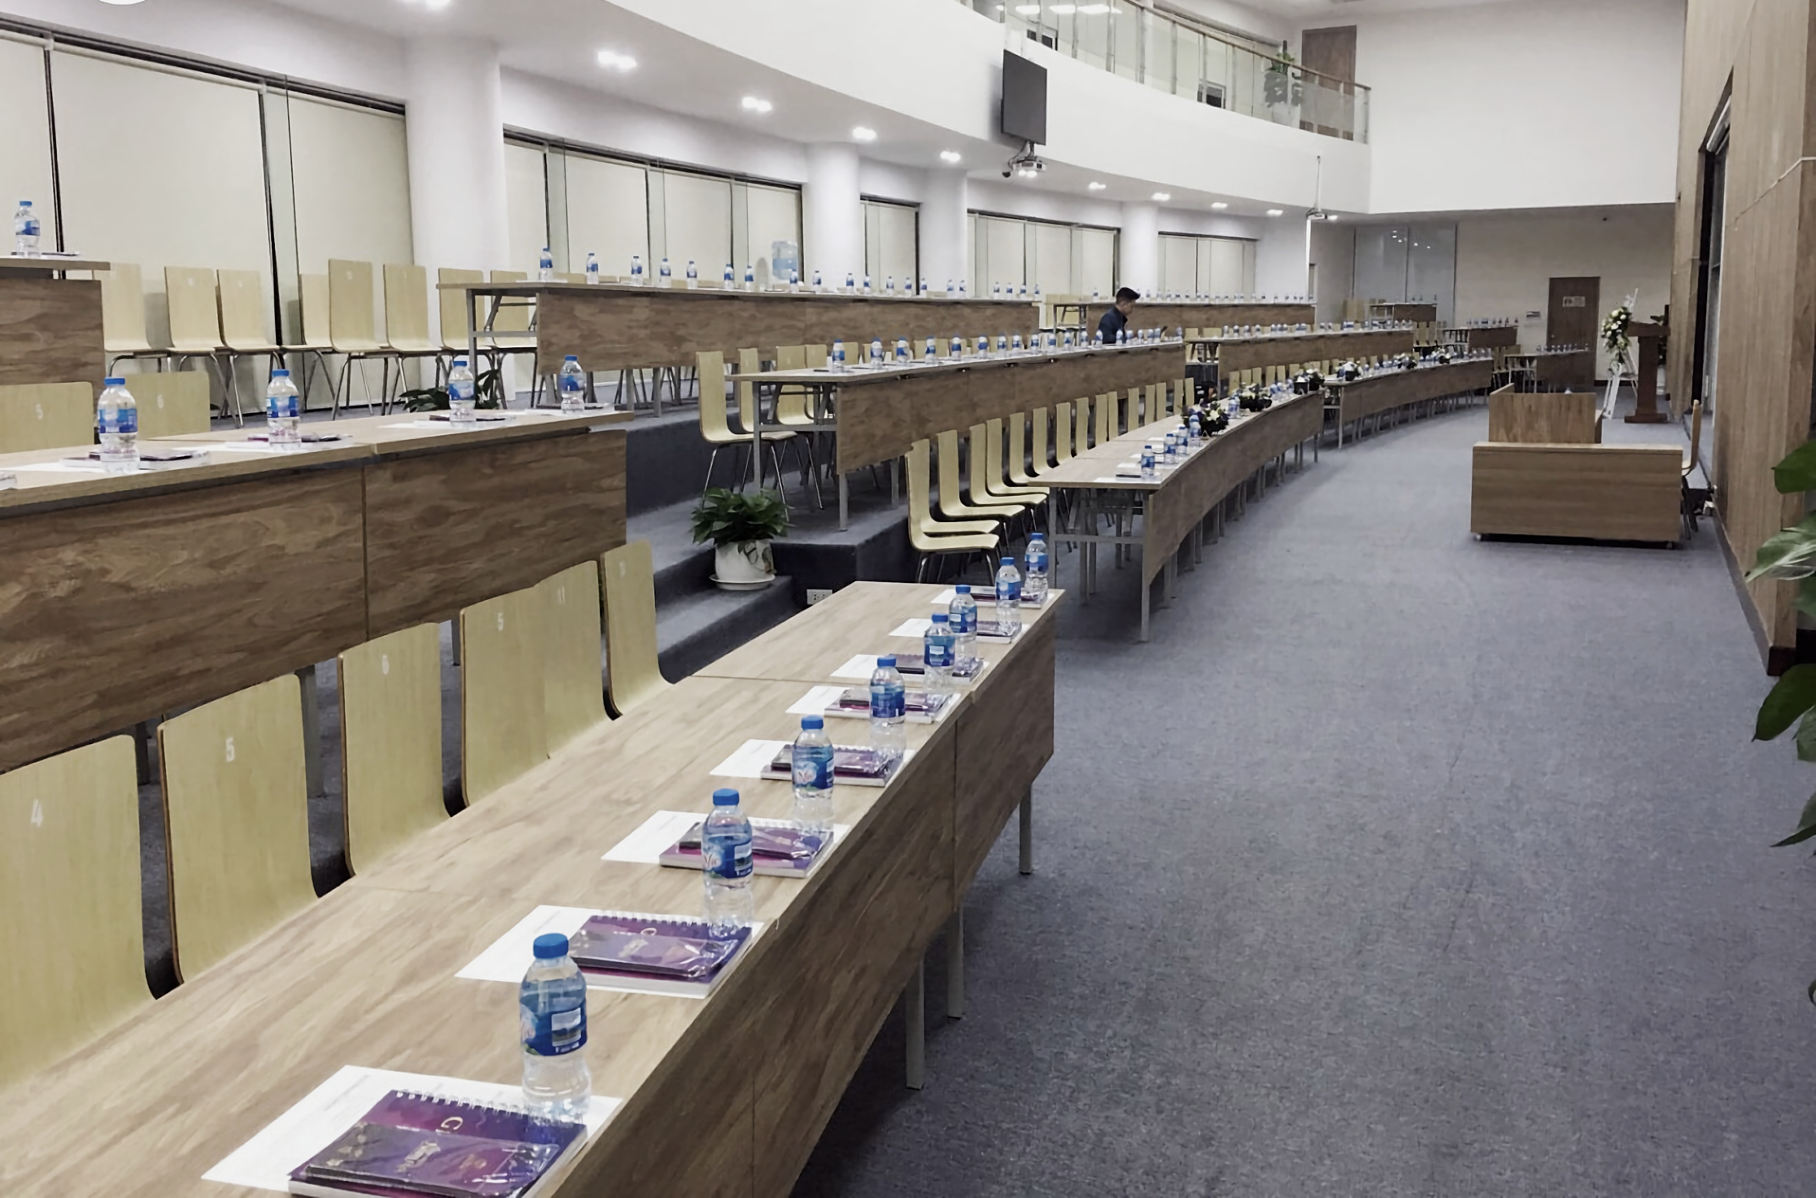
Workshop information
Time and place
Introduction
This workshop aims to provide useful information to help the company’s staff improve their skills in communicating with potential clients and generating more sales.
The event will be held at a Novaup meeting hall located at 34T Hoang Dao Thuy over a course of 2 days. With the capacity of 100 people that it has, a 2-day workshop would be able to allow all employees to participate and gain valuable insight from the experts.
[1]

Slide 3
Workshop information
Introduction
Agenda
Time and place
16:00 – 16:30
Closing entertainment and prizes
8:30 – 9:00
Registration and reception
9:20 – 9:30
Introduction
11:40 – 13:00
Lunch
The event will be held at a Novaup meeting hall located at 34T Hoang Dao Thuy over a course of 2 days. With the capacity of 100 people that it has, a 2-day workshop would be able to allow all employees to participate and gain valuable insight from the experts.
9:00 – 9:20
Opening ceremony
9:30 – 11:30
Speech from the speaker
13:00 – 16:00
Short speech, then free activity, interaction with experts
[2]
This workshop aims to provide useful information to help the company’s staff improve their skills in communicating with potential clients and generating more sales.

Slide 4
Workshop information
January
17
18
Febuary
1
19
20
21
22
23
24
25
26
27
28
29
30
31
2
3
4
5
6
7
8
9
Introduction
Planning schedule
Planning schedule
Time and place
Agenda
16:00 – 16:30
Closing entertainment and prizes
8:30 – 9:00
Registration and reception
9:20 – 9:30
Introduction
11:40 – 13:00
Lunch
Planning the workshop (17/1-19/1)
Planning the workshop
17-19
Prepare the workshop (20/1-21/1)
Prepare the workshop
20-21
Contact the speaker (24/1-25/1
Contact the speaker
24-25
Invite guests and participants (26/1-28/1)
Invite guests and participants
26-28
9:00 – 9:20
Opening ceremony
9:30 – 11:30
Speech from the speaker
13:00 – 16:00
Short speech, then free activity, interaction with experts
Set up the venue (31/1-1/2)
Set up the venue
31-1
Check-up and testing (2/2)
Check-up and testing
2
Workshop day 1 (7/2)
Workshop day 1
7
Workshop day 2 (8/2)
Workshop day 2
8
The event will be held at a Novaup meeting hall located at 34T Hoang Dao Thuy over a course of 2 days. With the capacity of 100 people that it has, a 2-day workshop would be able to allow all employees to participate and gain valuable insight from the experts.
This workshop aims to provide useful information to help the company’s staff improve their skills in communicating with potential clients and generating more sales.

Slide 5
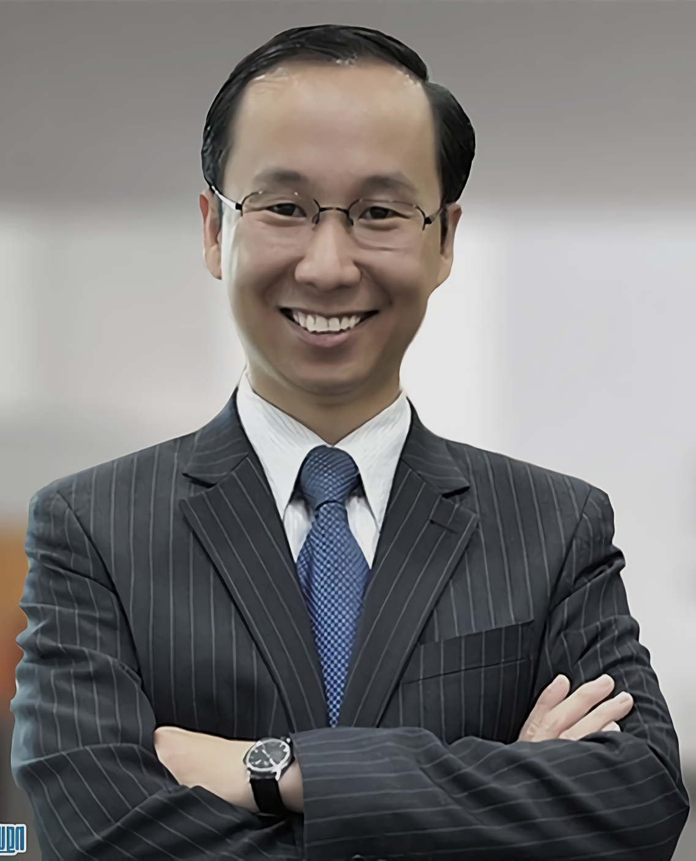
Workshop information
January
17
18
February
1
19
20
21
22
23
24
25
26
27
28
29
30
31
2
3
4
5
6
7
8
9
Introduction
Agenda
Experts/speakers invited
Time and place
Estimated budget
Planning schedule
16:00 – 16:30
Closing entertainment and prizes
The speaker is Vuong Huu Hung. With over 15 years of experience working in 10 different countries, he possesses the experience, knowledge, and insights that can greatly help our staff in improving their sales skills
8:30 – 9:00
Registration and reception
9:20 – 9:30
Introduction
11:40 – 13:00
Lunch
The speakers invited for this workshop are “” and “”
Planning the workshop (17/1-19/1)
Prepare the workshop (20/1-21/1)
Contact the speaker (24/1-25/1
Invite guests and participants (26/1-28/1)
9:00 – 9:20
Opening ceremony
9:30 – 11:30
Speech from the speaker
13:00 – 16:00
Short speech, then free activity, interaction with experts
Set up the venue (31/1-1/2)
Check-up and testing (2/2)
Workshop day 1 (7/2)
Workshop day 2 (8/2)
The event will be held at “” over a course of 2 days. With the capacity of “” that it has, 2 days would be able to allow all employees to participate and gain valuable insight from the experts.
This workshop aims to provide useful information to help the company’s staff improve their skills in communicating with potential clients and generating more sales.

Slide 6







Workshop information
January
17
18
Febuary
1
19
20
21
22
23
24
25
26
27
28
29
30
31
2
3
4
5
6
7
8
9
Introduction
Planning schedule
Agenda
Time and place
Estimated budget
Experts/speakers invited
14:00 – 16:00
Free activity, interaction with experts
The speaker is Vuong Huu Hung. With over 15 years of experience working in 10 different countries, he possesses the experience, knowledge, and insights that can greatly help our staff in improving their sales skills
9:00 – 10:00
Registration and reception
10:20 – 10:40
Introduction
11:40 – 13:00
Lunch
Planning the workshop (17/1-19/1)
Planning the workshop
17-19
Prepare the workshop (20/1-21/1)
20-21
Prepare the workshop
Contact the speaker (24/1-25/1
Contact the speaker
24-25
Invite guests and participants (26/1-28/1)
26-28
10:40 – 11:40
Speech from the first speaker
13:00 – 14:00
Speech from the second speaker
Invite guests and participants
9:00 – 9:20
Opening ceremony
Set up the venue (31/1-1/2)
Set up the venue
31-1
Check-up and testing (2/2)
Check-up and testing
2
Total: 115.400.000₫
[3]
Workshop day 1 (7/2)
Workshop day 1
7
Workshop day 2 (8/2)
Workshop day 2
8
The event will be held at “” over a course of 2 days. With the capacity of “” that it has, 2 days would be able to allow all employees to participate and gain valuable insight from the experts.
This workshop aims to provide useful information to help the company’s staff improve their skills in communicating with potential clients and generating more sales.
Venue
56.000.000₫
Speaker/MC
10.400.000₫
Equipment
5.000.000₫
Food/drink
30.000.000₫
Transport
2.000.000₫
Entertainment
7.000.000₫
Decoration
5.000.000₫

Slide 7


Workshop information
Reference
Introduction
Planning schedule
Agenda
Experts/speakers invited
Time and place
Estimated budget
Venue
56.000.000₫
Speaker/MC
10.400.000₫
Equipment
5.000.000₫
Food/drink
30.000.000₫
14:00 – 16:00
Free activity, interaction with experts
The speaker is Vuong Huu Hung. With over 15 years of experience working in 10 different countries, he possesses the experience, knowledge, and insights that can greatly help our staff in improving their sales skills
9:00 – 10:00
Registration and reception
10:20 – 10:40
Introduction
11:40 – 13:00
Lunch
The speakers invited for this workshop are “” and “”
Transport
2.000.000₫
Entertainment
7.000.000₫
Decoration
5.000.000₫
10:00 – 10:20
Opening ceremony
10:40 – 11:40
Speech from the first speaker
13:00 – 14:00
Speech from the second speaker
Total: 115.400.000₫
The event will be held at “” over a course of 2 days. With the capacity of “” that it has, 2 days would be able to allow all employees to participate and gain valuable insight from the experts.
This workshop aims to provide useful information to help the company’s staff improve their skills in communicating with potential clients and generating more sales.
Speaker’s biography
Group, T.L., 1970. Vương Hữu Hùng - Diễn Giả. DANH NHÂN VĂN HÓA ONLINE. Available at: http://www.danhnhan.net/2012/03/francis-hung.html [Accessed January 18, 2022].
Image
[1] 3D Flame, Epic fail, Available at: https://icons8.com/illustrations/illustration/3d-flame-epic-fail-2.
[2] Anon, Phòng hội thảo, Available at: https://novaup.vn/uploads/photos/images/2020/06/phong-hoi-thao/hoi-truong-lon-34t-hoang-dao-thuy-20.jpg.
[3] Anon, Available at: https://nguoinoitieng.tv/nghe-nghiep/dien-gia/francis-hung/am5.
Icons
Icons are taken from https://icons8.com/icons

Slide 8
Workshop information
Reference
Introduction
Planning schedule
Image
[1] 3D Flame, Epic fail, Available at: https://icons8.com/illustrations/illustration/3d-flame-epic-fail-2.
[2] Anon, Phòng hội thảo, Available at: https://novaup.vn/uploads/photos/images/2020/06/phong-hoi-thao/hoi-truong-lon-34t-hoang-dao-thuy-20.jpg.
[3] Anon, Available at: https://nguoinoitieng.tv/nghe-nghiep/dien-gia/francis-hung/am5.
Speaker’s biography
Group, T.L., 1970. Vương Hữu Hùng - Diễn Giả. DANH NHÂN VĂN HÓA ONLINE. Available at: http://www.danhnhan.net/2012/03/francis-hung.html [Accessed January 18, 2022].
Agenda
Experts/speakers invited
Time and place
Estimated budget
14:00 – 16:00
Free activity, interaction with experts
The speaker is Vuong Huu Hung. With over 15 years of experience working in 10 different countries, he possesses the experience, knowledge, and insights that can greatly help our staff in improving their sales skills
9:00 – 10:00
Registration and reception
10:20 – 10:40
Introduction
11:40 – 13:00
Lunch
The speakers invited for this workshop are “” and “”
Equipment
5.000.000₫
Food/drink
30.000.000₫
Icons
Icons are taken from https://icons8.com/icons
10:00 – 10:20
Opening ceremony
10:40 – 11:40
Speech from the first speaker
13:00 – 14:00
Speech from the second speaker
Venue
56.000.000₫
Speaker/MC
10.400.000₫
Decoration
5.000.000₫
Transport
2.000.000₫
Entertainment
7.000.000₫
The event will be held at “” over a course of 2 days. With the capacity of “” that it has, 2 days would be able to allow all employees to participate and gain valuable insight from the experts.
This workshop aims to provide useful information to help the company’s staff improve their skills in communicating with potential clients and generating more sales.
Total: 115.400.000₫

